Slide 1
Study of the DCNN method applicability to reduce the routine work of a CFD-engineer
Presentation of the Final project on the SkillFactory course in Data Science
Cheremisov Stanislav
2022/01/21

Slide 2

Agenda
Background and Purpose
Machine learning and CFD
Conception
Workflow
DCNN model
Results
Conclusions and Summary

Slide 3
Agenda
Background and Purpose
Machine learning and CFD
Conception
Workflow
DCNN model
Results
Conclusions and Summary

Slide 4
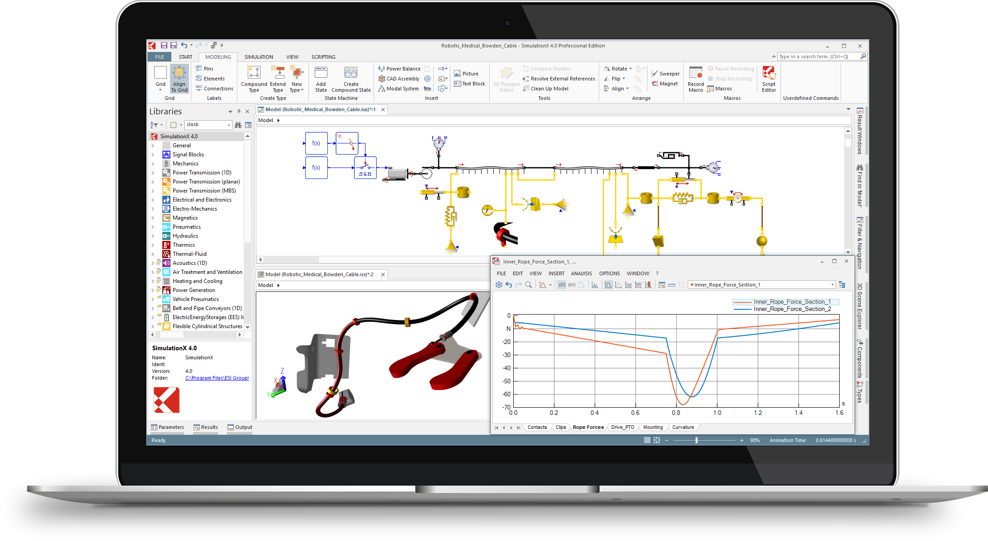
Background
The need to reduce the time to perform relatively simple, but at the same time routine and frequently occurring CFD analysis of various purposes pipelines
※CFD - Computational Fluid Dynamics; CAE – Computer-aided engineering
Notes:
Вычислительная гидродинамика (CFD) дает инженерам возможность получить tochnoe/подробное описание свойств/parametrov потока жидкости v chastnosti I parametrov kakoi-libo sistemy v celom eshe na etape proektirovaniya do izgotovleniya prototipa. V svoe vremya eto pozvolilo suchestvenno sokratit rashody na ispytaniya i sokratit samo vremya proektirovaniya produkta.
Odnako s rostom slozhnosti tehniki I stremleniyu k uluchsheniyu ee harakteristik. Stalo slozhnee priderzhivatsya ustoyavsheisya praktike, kogda pri proektirovanii novogo produkta mozhno bylo provesti prikidochnyi raschet gde nibud v excel, po etim dannym narisovat prototip I tolko uzhe ego otpravit v ruki ingenera raschetchika dlya proverki/ispytanii.
Tak kak pomimo uvelicheniya obema takih prikidochnyh raschetov, uvelichivaetsya I ih kolichestvo. Vse chasche stanovitsya neobhodimym provodit seriyu iz neskolkih desyatkov ili dazhe soten takih raschetov dlya poiska optimalnoi konfiguracii sistemy.
Chto estestvennym obrazom srazuzhe delaet ruchnyi raschety besperspektivnymi.
Variant otdat eto vse na otkup vychislitelnoi gidrodinamike tak zhe ne podhodit po neskolkim prichinam:
Vo-pervyh, eto silno peregruzit rabotoi inzhenerov CFD. Tak kak pomimo samih raschetov modeli nuzho podgotovit, zaparametarizirovat I t.d.
(Pri etom Nanyat bolshie shat tak zhe ne budet yavlyatsya vyhodom., tak kak podobnye raboty ne sovsem regulyarny. I ravnomernoi zagruzhenosti dobitsya budet tyazhelo.)
Vo-vtoryh, I ona zhe glavnaya, eto vremya provedeniya takogo kolichestva raschetov. To est Потоки жидкости описываются уравнениями Навье – Стокса, которые представляют собой дифференциальные уравнения в частных производных (УЧП), моделирующие сохранение массы и количества движения в ньютоновской жидкости. Эти diferencialnye uravneniya нелинейны из-за effekta турбулентность. Решение takih уравнений Навье-Стокса для турбулентных течений samo po sebe dorogo s tochki zreniya vychislenii.
Alternativoi ruchnomym raschetam I raschetam CFD yavlyaetsya ispolzovanie tak nazyvaemyi podhoda 1D CAE. On predstavlyaet iz sebya nekoe programnoe obespechenie, dayuschee vozmozhnost sobirat model sistemy iz zaranee zaprogramirovannyh blokov.
Odnako I u nego est nedostatki:
Naprimer, tak kak kazhdyi blok predstavlyaet iz sebya nabor nekih analiticheskih uravnenii tochost raschetov silno zavisit ot stepeni podgotovki operatora/inzhenera. (naskolko on tochno podberet koefficienty)
Tak zhe v sluchae s gidrodinamikloi, naprimer pri raschete truboprovoda, obychye analiticheskie uravneniya nesposobny peredat vse parametry/sostoyaniya zhidkosti, I naprimer blok obschityvayuschii povorot na 90 gradusov (tak nazyvaemoe koleno) ne budet prinimat vo vnimanie v kakoi otnositelnoi pozicii byl raspolozhen predyduschii blok. Esli naprimer eto dva kolena, to oni mogut byt libo v odnoi ploskosti libo perpendikulyarno drug drugu I tak dalie.
Otsyuda voznikla ideya poprobovat obedinit podhody 1D CAE I CFD za schet obucheniya neiro seti.

Slide 5
Purpose
Evaluate the consistency and effectiveness of using DCNN to solve the problem, as well as the total labor and time costs (for model preparing & etc.)
Apply the knowledge and skills gained in the course to solve a practical problem
Gain new experience
※DCNN – Deep Convolutional Neural Networks
Notes:
Celyu dannoi raboty yavlyalos, Оценить состоятельность и эффективность применения Deep Convolutional Neural Networks для решения oboznachennoi задачи, а также ocenit общие трудо- и время- затраты (на podgotovku, обучение модели и т.д.)
T.e. zadachu
A tak zhe celymi byli Применить полученные на курсе знания и навыки для решения практической (насущной) задачи
Получить новый опыт

Slide 6
Agenda
Background and Purpose
Machine learning and CFD
Conception
Workflow
DCNN model
Results
Conclusions and Summary
Notes:
Davaite seichas pereidem k obzoru pohozhih proektov kotorye ya smog naiti.

Slide 7
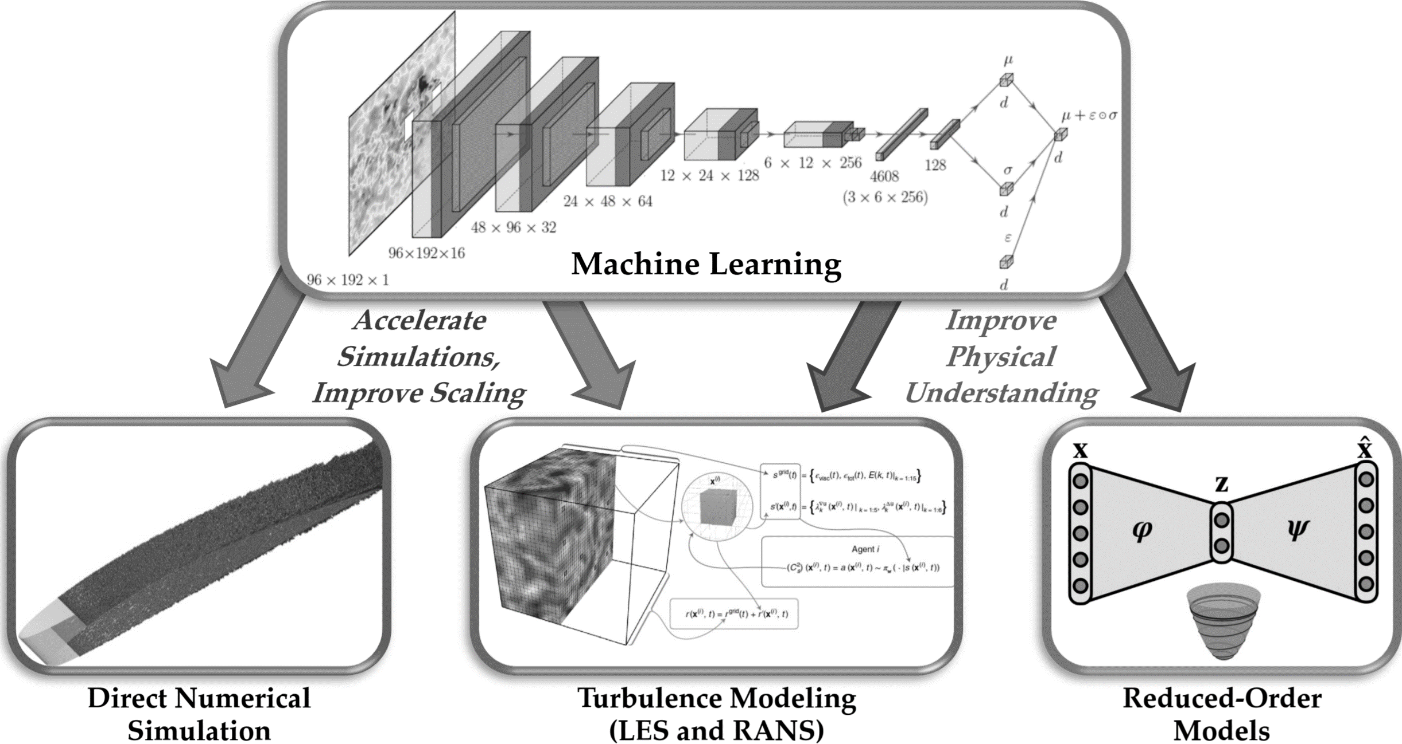
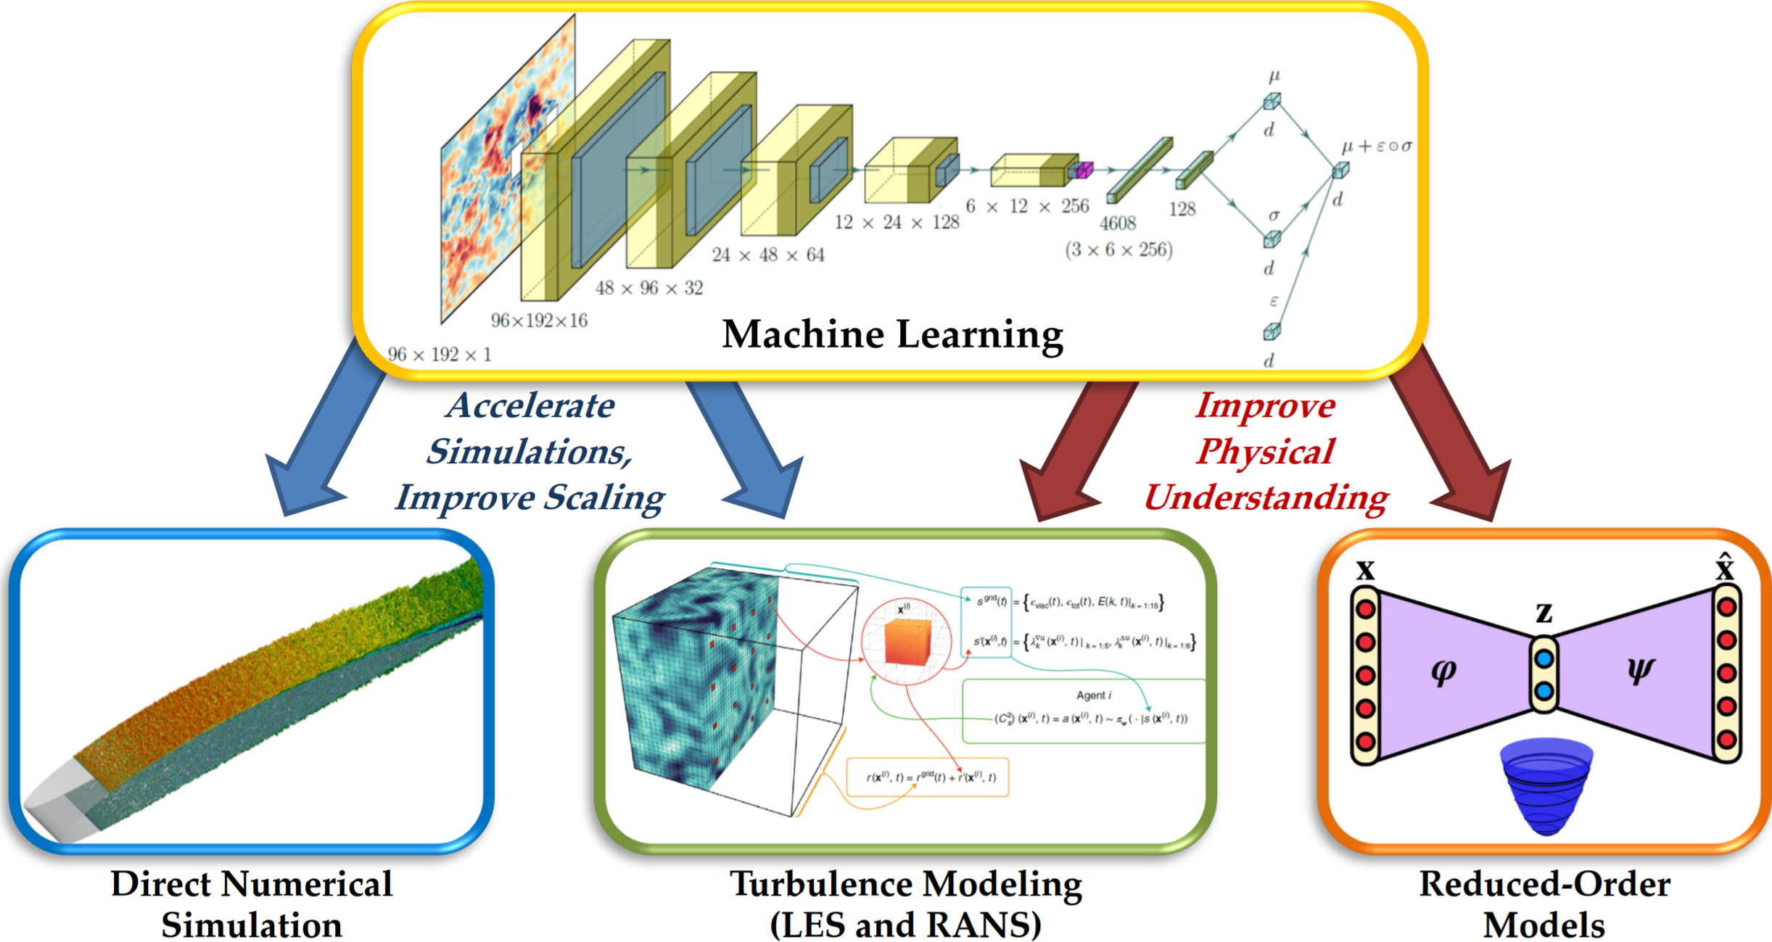
Machine learning and CFD
※Ricardo Vinuesa and Steven L. Brunton, arXiv:2110.02085, 2021
Notes:
Uslovno proekty po sovmestnomu primeneniyu mashinnogo obucheniya i CFD mozhno razdelit na dva vida.
Pervyi, nosit v pervuyu ochered akademicheskii /developerskii harakter, eto uskorenie raschetov CFD za schet vnedreniya neironnyh setei neposredstvenno v vychislitelnuyu chast.
T.e. naprimer v sluchae DNS metodom, (yavlyayuschiisya na dannyi moment samym prodvinutym, no v tozhe vremya samym resursoemkim, tak kak trebuet razmer yacheiki raschetnoi setki soizmerimyi s razmerov samogo melkogo vihrya.), neiro set predskazyvaet ne razreshennye raschetnoi setkoi melkie vihri.
Libo prosto uskarya raschety za schet predskazyvaniya nekotoryh chastei uravnenii.
Vtoroi variant primrnrniya ML v CFD, eto umenshenie kolichestva modelei neobhodimyh k raschetu.
T.e. obuchiv neroset na uzhe imeyuschihsya resultatah, my poluchaem vozmozhnost ne provodya raschety poluchit ih rezultat.
Sobstvenno ko vtoromu vidu proektov I itnositsya dannaya rabota.

Slide 8
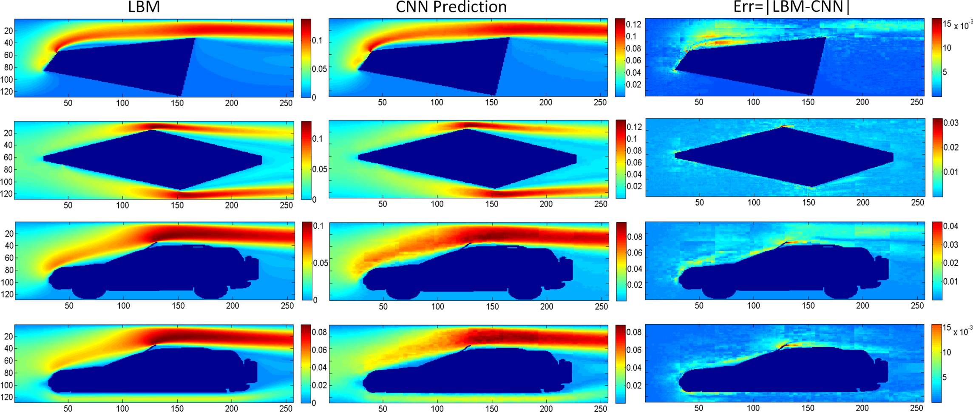
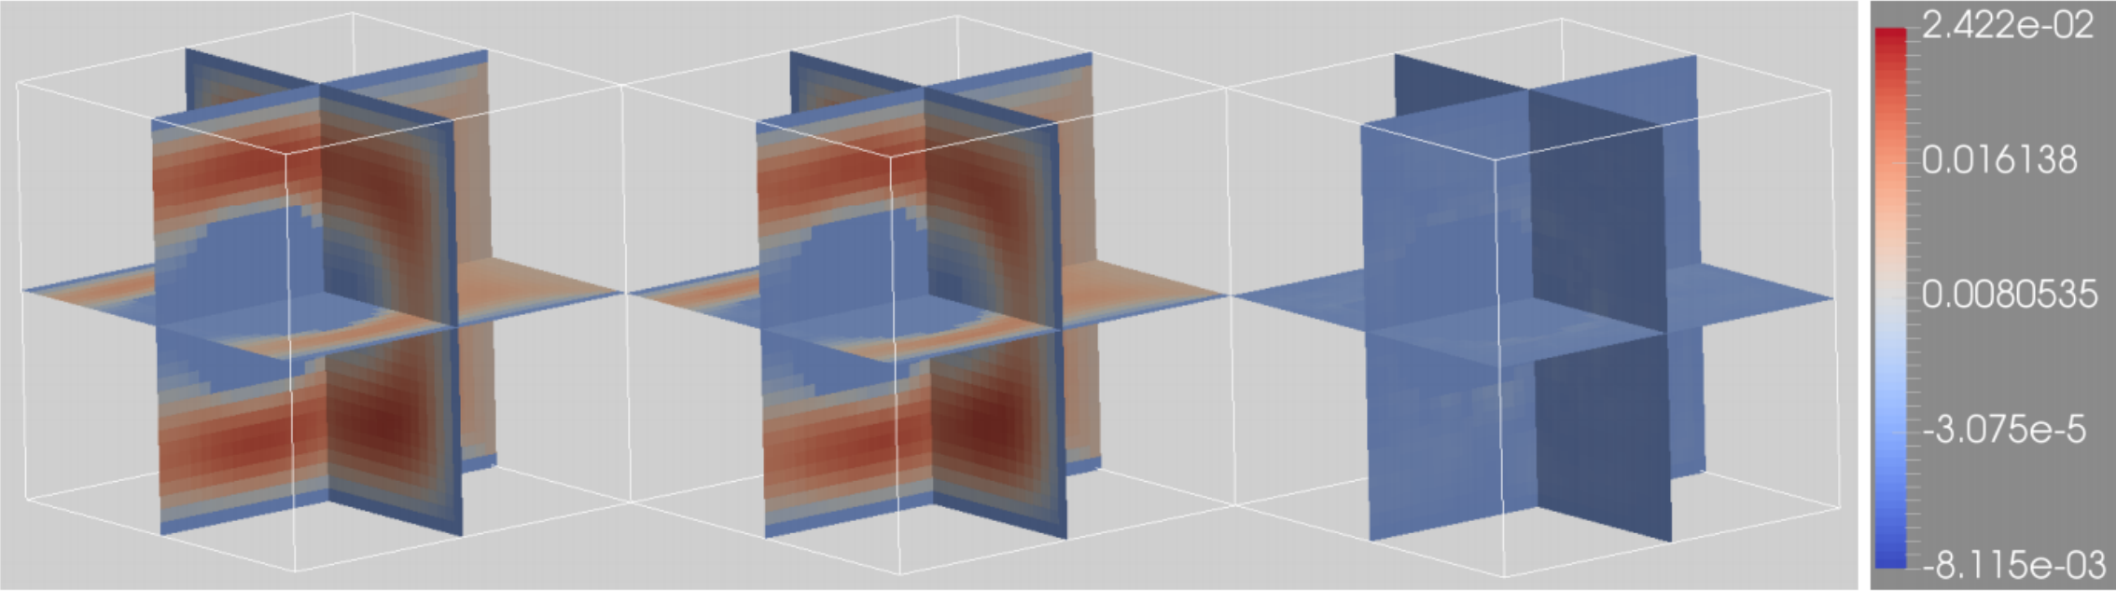
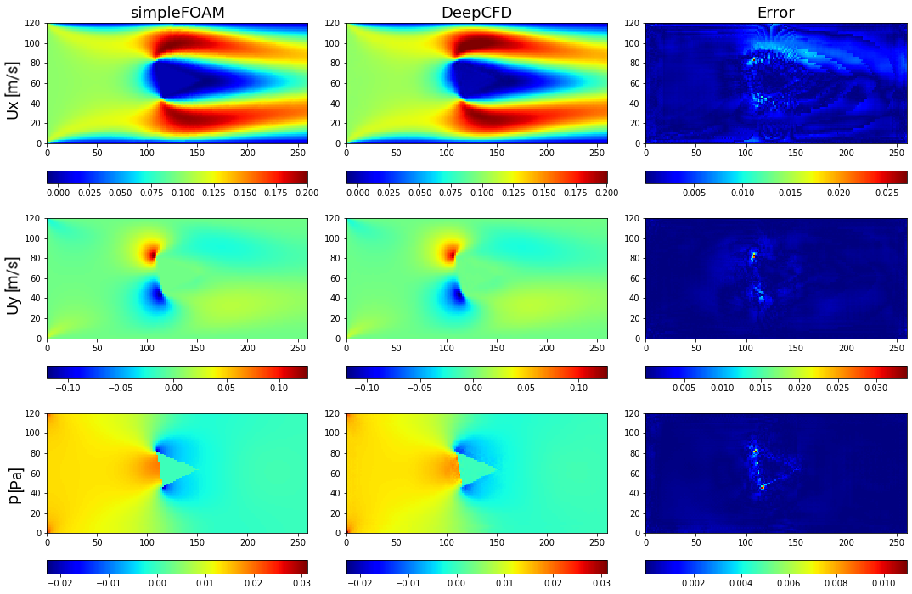
Machine learning and CFD
Most of the projects, that have chosen way "Reduced-Order Models“, are focused on solving problem of the flow around an obstacle
Newest project with good performance is “Deep CFD” [Mateus Dias Ribeiro at al., arXiv:2004.08826, 2020]
But the calculation field in which an obstacle is placed has a limited size

Slide 9
Agenda
Background and Purpose
Machine learning and CFD
Conception
Workflow
DCNN model
Results
Conclusions and Summary
Notes:
Davaite seichas pereidem k obzoru pohozhih proektov kotorye ya smog naiti.

Slide 10
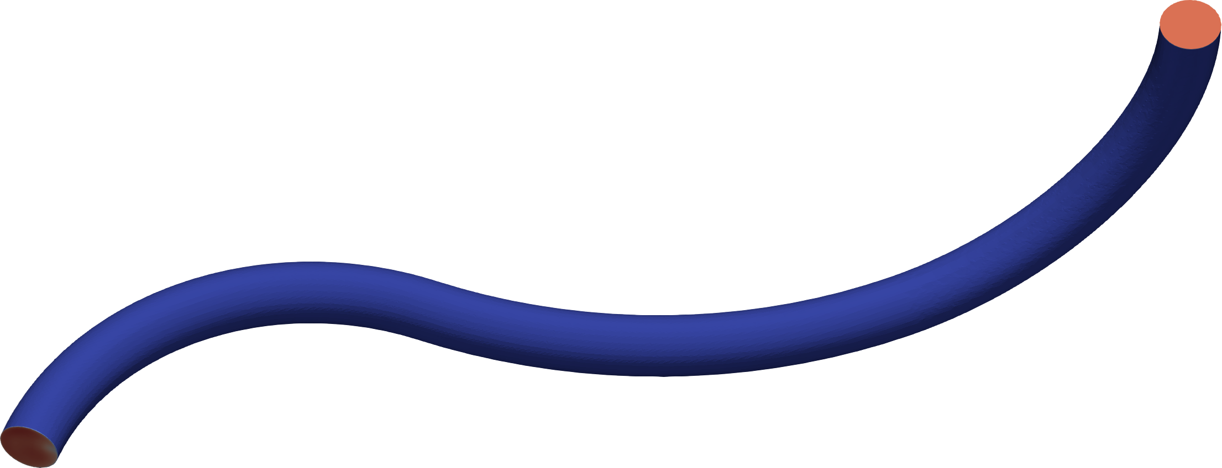
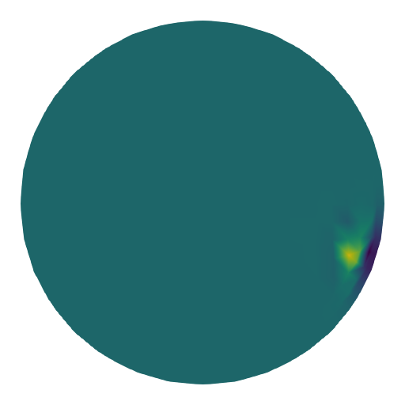
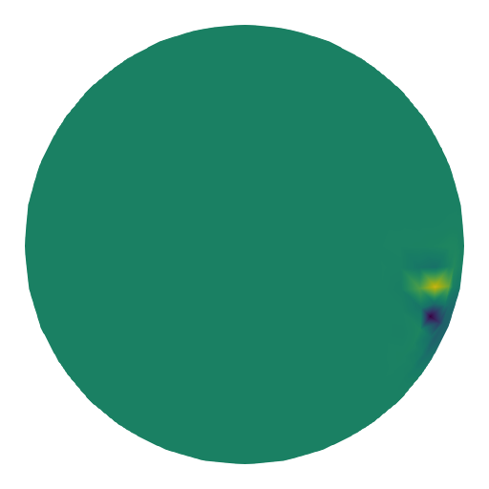


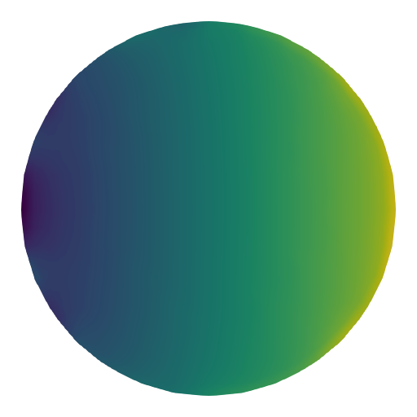
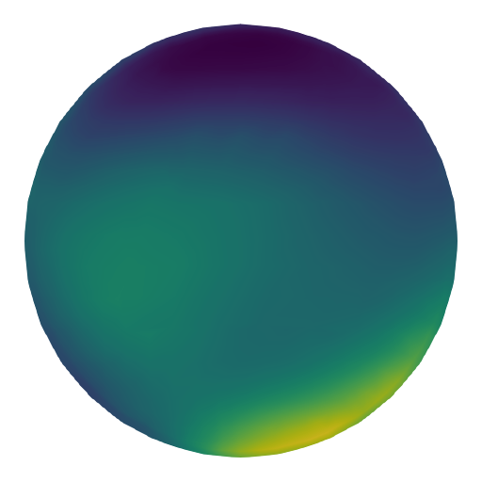
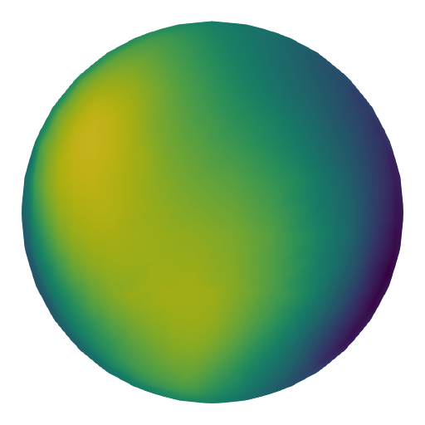
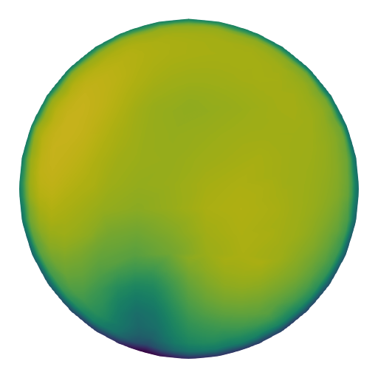
Conception: Requirements
Want to be able to analyze "infinitely“ long pipelines of "arbitrary" shape
Want to obtain the main characteristics of the pipeline (pressure loss and velocity) from the initial "arbitrary" flow parameters
Outlet►
Inlet
▼
Velocity components distribution fields
Pressure distribution field
Initial
Ux
Uy
Uz
P
Pressure distribution field
Velocity components distribution fields
Want to get
P
Ux
Uy
Uz

Slide 11
Conception: How to
Split the original geometry into primitives
Use the inlet and outlet parameters of each primitives for training
Give NN model information about the shapes (type, length, diameter, radius) of the current, previous and next sections
Initial
Pressure
Section 1
▼
Section 3►
Section 2
▼
Outlet for Section 1
Inlet fro Section 2
Outlet for Section 2
Inlet fro Section 3
Initial
Velocity components
Original model
(1 initial set)
Shape info
Section 1
Set for training
Section 2
Set for training
Section 2
Set for training

Slide 12
Agenda
Background and Purpose
Machine learning and CFD
Conception
Workflow
DCNN model
Results
Conclusions and Summary
Notes:
Davaite seichas pereidem k obzoru pohozhih proektov kotorye ya smog naiti.

Slide 13
Workflow
Step 1: Data parsing
CAD model Generating
CFD Pre-processing
CFD Solving
CFD Post-processing
CadQuery
Python script
FreeCAD
Add-on: CfdOF
Python script (Macros)
OpenFOAM
SimpleFOAM solver
Bash-scripts
ParaView
Python script (Macros)
Totally 2058 models
About 200 row of code
Runtime 3 min 15 sec
About 300 row of code
Runtime about 24 hrs
2 bash-scripts to automate the process
Runtime about 1 week on 2 workstations
About 250 row of code
Runtime about 12 hrs
Totally 6024 input sets (15 files was broken)
Including max and min values of each cross section
CadQuery : https://github.com/CadQuery/cadquery
FreeCAD : https://www.freecadweb.org/
CfdOF add-on : https://github.com/jaheyns/CfdOF
OpenFOAM : https://www.openfoam.com/
ParaView : https://www.paraview.org/

Slide 14
Agenda
Background and Purpose
Machine learning and CFD
Conception
Workflow
DCNN model
Results
Conclusions and Summary
Notes:
Davaite seichas pereidem k obzoru pohozhih proektov kotorye ya smog naiti.

Slide 15
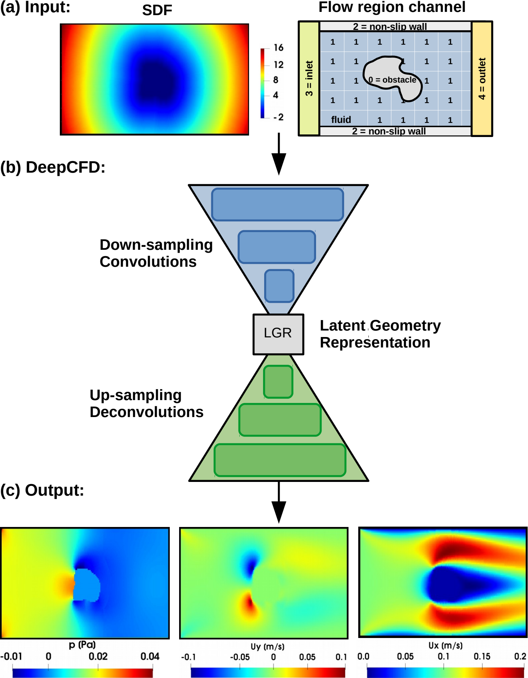
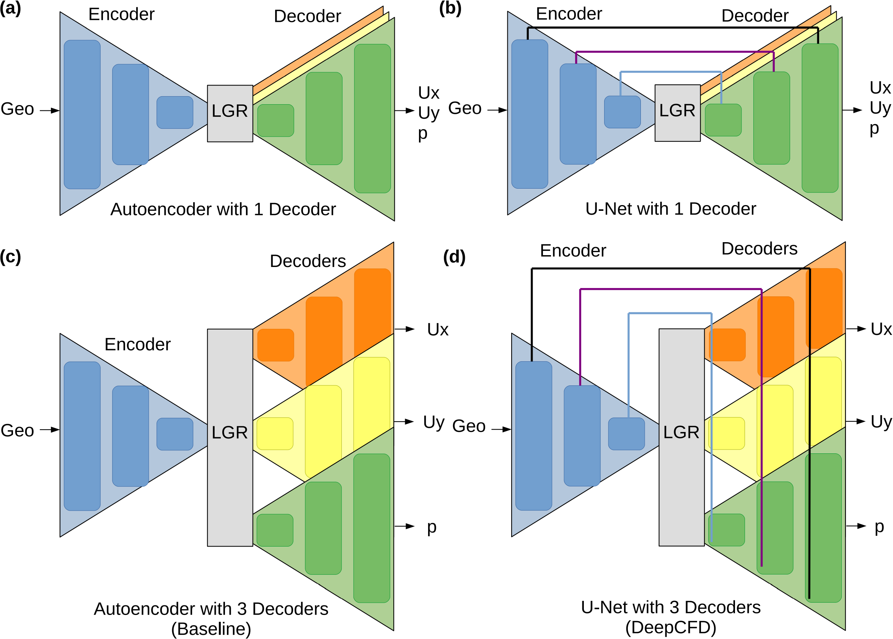
DCNN Model: DeepCFD
※Mateus Dias Ribeiro at al., arXiv:2004.08826, 2020

Slide 16

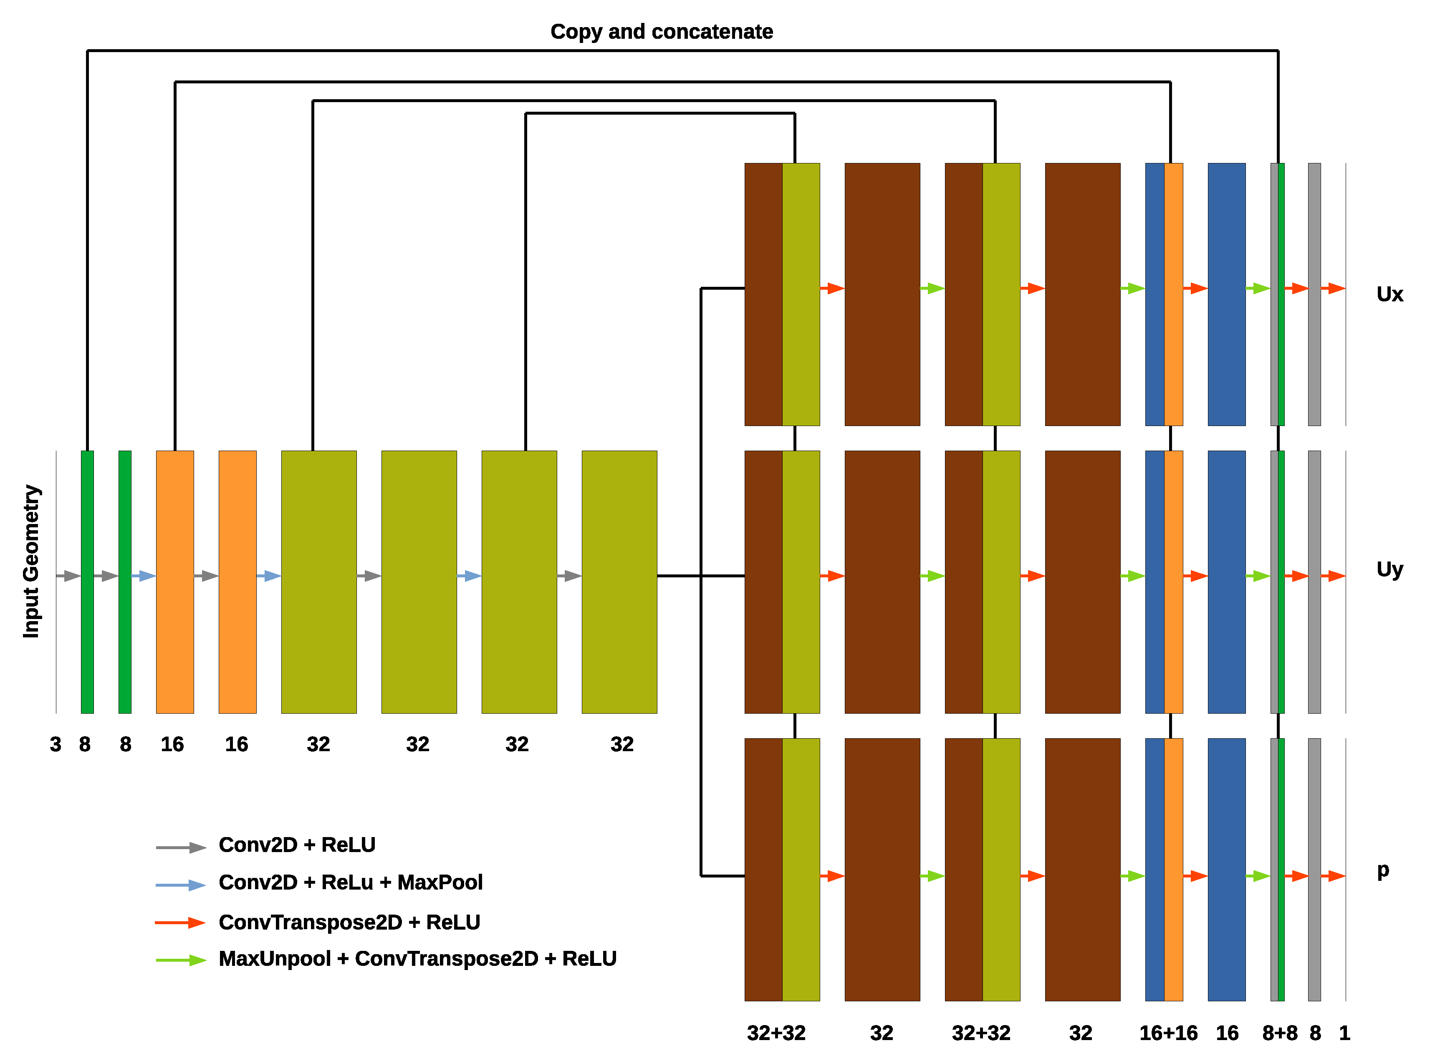
DCNN Model: DeepCFD
※Mateus Dias Ribeiro at al., arXiv:2004.08826, 2020

Slide 17
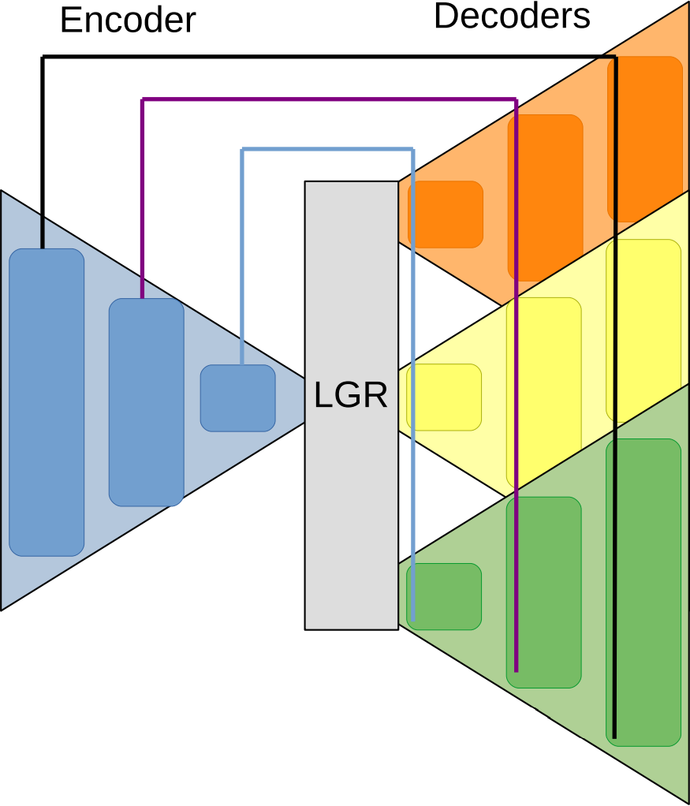
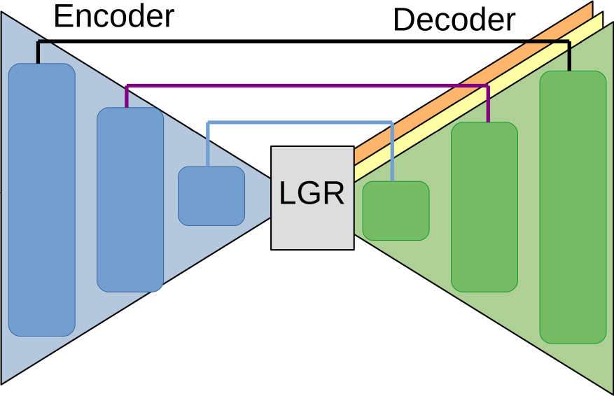
DCNN Model
Model V: Velocity to Velocity
Outlet►
Ux
Ux
Uy
Inlet
▼
Uy
Uz
Uz
G
Velocity components distribution fields
Pressure distribution field
Model P: Pressure+Velocity to Pressure
Initial
Ux
Ux
Uy
Uz
P
Uy
Pressure distribution field
Velocity components distribution fields
P
Uz
Want to get
Uz
P
P
Ux
Uy

Slide 18
DCNN Model: Inference
Initial
P
Predicted
Ux, Uy, Uz
Section 1
▼
Predicted
P
Section 2
▼
Predicted
P
◄Section 3
Predicted
P
Predicted
Ux, Uy, Uz
Predicted
Ux, Uy, Uz
Initial
Ux, Uy, Uz
Initial
Ux, Uy, Uz
Model V
Predict 1:
Ux, Uy, Uz
Model V
Predict 2:
Ux, Uy, Uz
Predict N-1:
Ux, Uy, Uz
Model V
Predict N:
Ux, Uy, Uz
Section 1
Section 2
Section N
Predict N:
P
Model P
Predict N-1:
P
Model P
Predict N-2:
P
Predict 1:
P
Model P
Initial
P

Slide 19
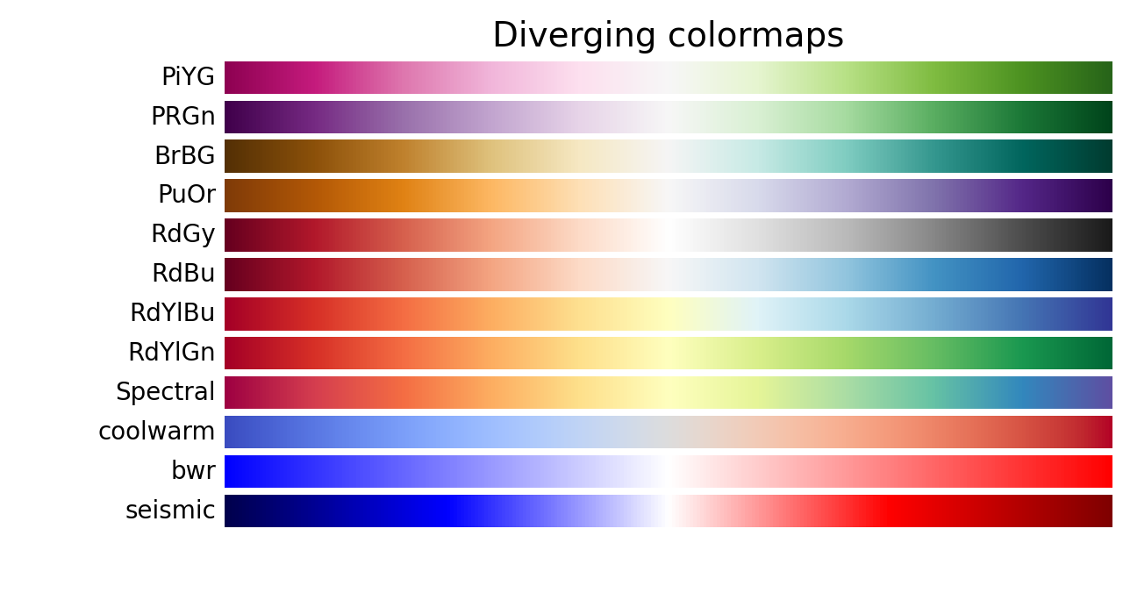
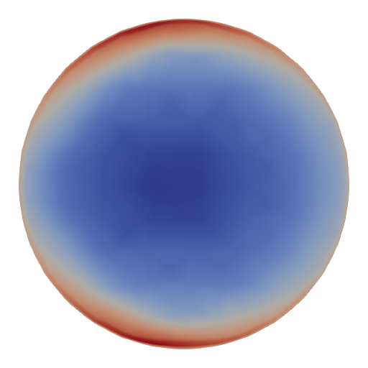
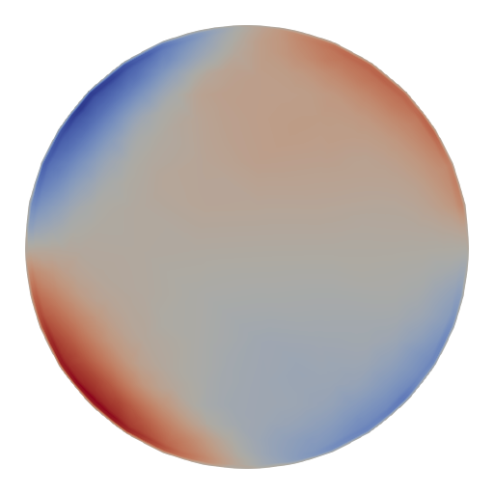
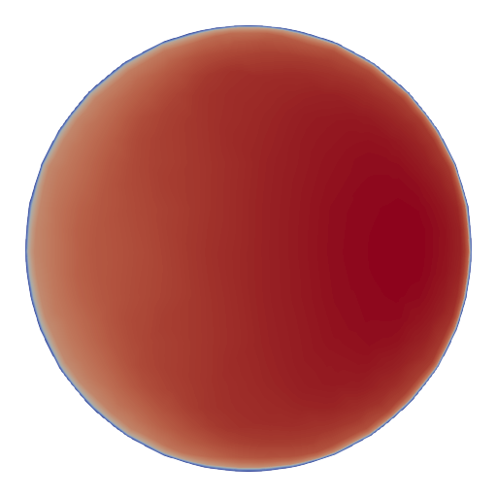
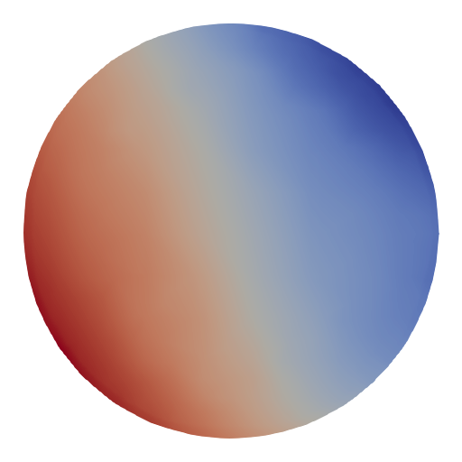
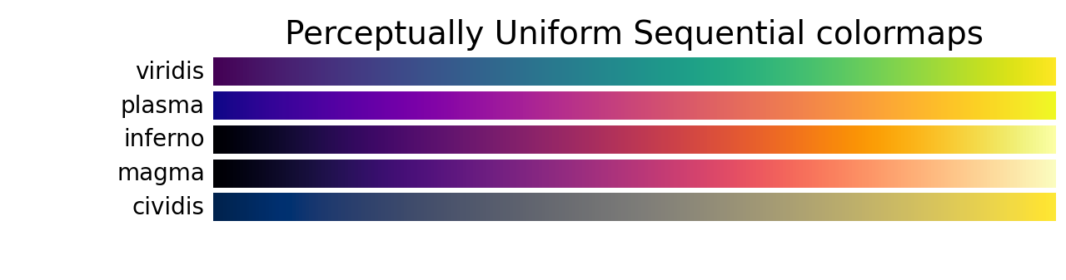
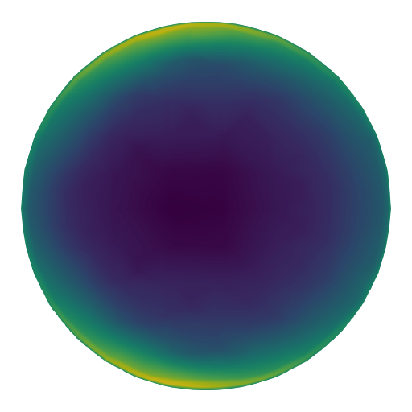
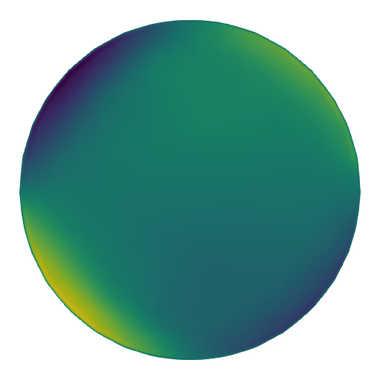
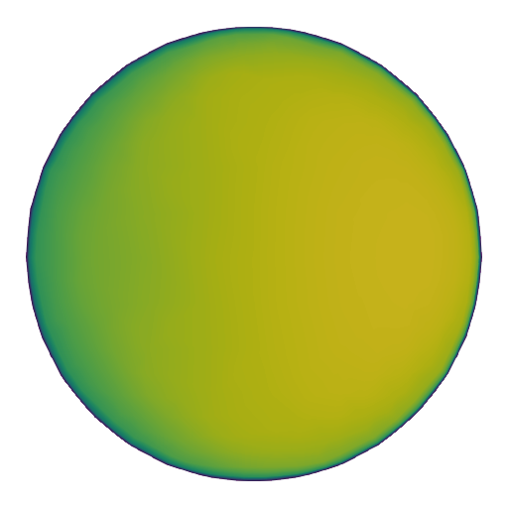

DCNN Model: Data preparing
Diverging
For the Diverging maps, we want to have monotonically increasing L* values up to a maximum, which should be close to L*=100, followed by monotonically decreasing L* values. We are looking for approximately equal minimum L* values at opposite ends of the colormap. By these measures, BrBG and RdBu are good options. coolwarm is a good option, but it doesn't span a wide range of L* values (see grayscale section below).
Sequential
For the Sequential plots, the lightness value increases monotonically through the colormaps. This is good. Some of the L* values in the colormaps span from 0 to 100 (binary and the other grayscale), and others start around L*=20. Those that have a smaller range of L* will accordingly have a smaller perceptual range. Note also that the L* function varies amongst the colormaps: some are approximately linear in L* and others are more curved.

Slide 20
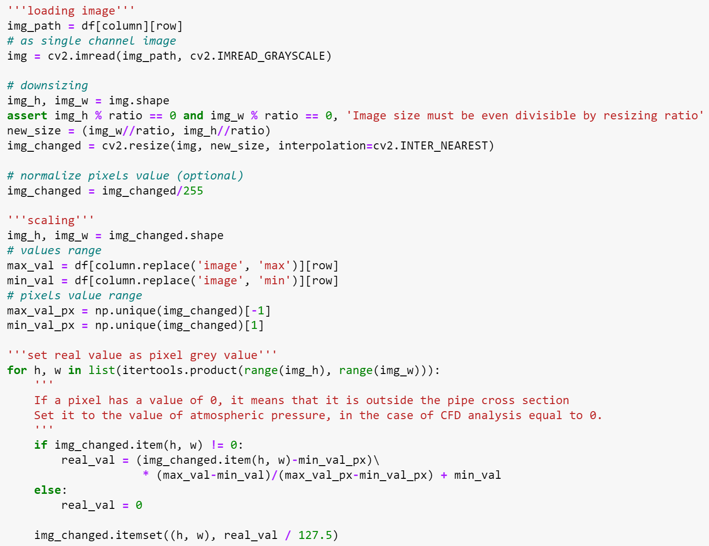
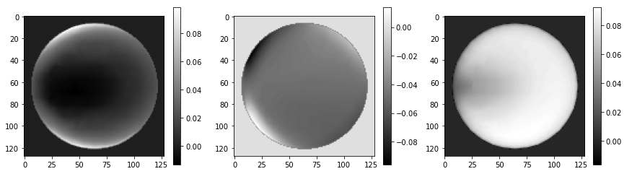
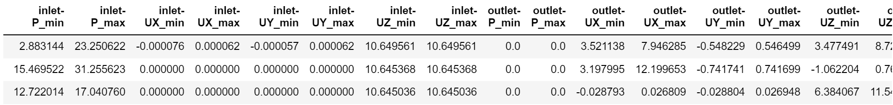
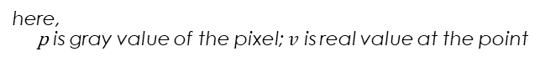
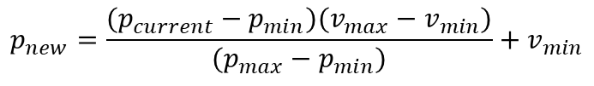
DCNN Model: Data preparing
Converting a multi-channel image to a single channel
Normalizing range of values ([-1:1])
Changing color value to real value
①
②
$$p_{new}=\frac{(p_{current}−p_{min})(v_{max}−v_{min})}{(p_{max}−p_{min})}+v_{min}$$
here, p is gray value of the pixel; $v$ is real value at the point
③

Slide 21
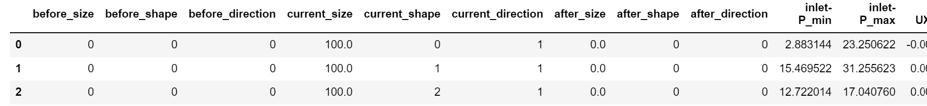
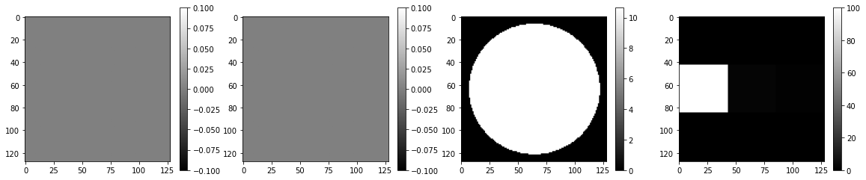
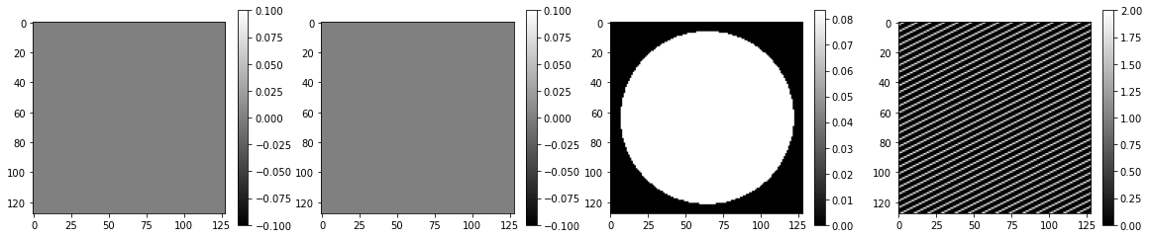
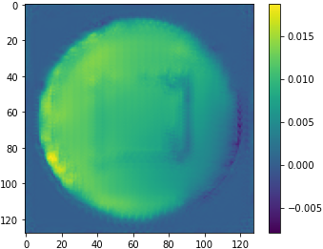
DCNN Model: Data preparing
Label encoding of “*size” column
Using Tessellation instead Tile
0 | 0 | 0 | 1 | 2 | 1 | 0 | 0 | 0
0 | 0 | 0 | 1 | 2
1 | 0 | 0 | 0
0 | 0 | 0 | 1 | 1 | 2 | 1 | 0 | 1

Slide 22
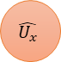
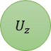
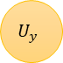
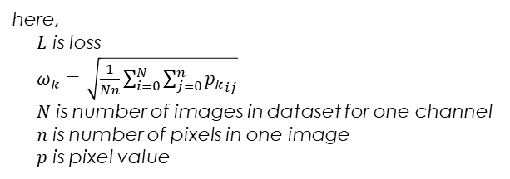
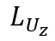
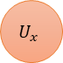
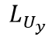
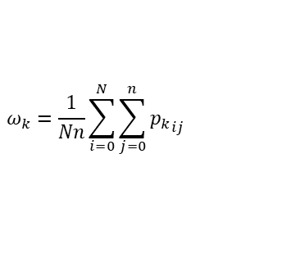
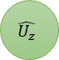
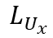

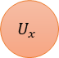
DCNN Model: Loss function
$$ω_{k}=\frac{1}{Nn}\sum_{i=0}^{N}{\sum_{j=0}^{n}{{p_{k}}_{ij}}}$$
Ux
$$\hat{U_{x}}$$
$$U_{x}$$
$$L_{U_{x}}$$
$$L_{total}=ω_{U_{x}}L_{U_{x}}+ω_{U_{y}}L_{U_{y}}+ω_{U_{z}}L_{U_{z}}$$
$$U_{x}$$
$$U_{x}$$
Uy
here,
$L$ is loss
$ω_{k}=\sqrt{\frac{1}{Nn}\sum_{i=0}^{N}{\sum_{j=0}^{n}{{p_{k}}_{ij}}}}$ $N$ is number of images in dataset for one channel
$n$ is number of pixels in one image
$p$ is pixel value
$$U_{x}$$
$$\hat{U_{y}}$$
$$U_{y}$$
$$L_{U_{y}}$$
Uz
$$\hat{U_{z}}$$
$$U_{z}$$
$$L_{U_{z}}$$
G

